Slide 1
Top-Down Parsing
Compiler Construction
Khawaja 2025

Slide 2
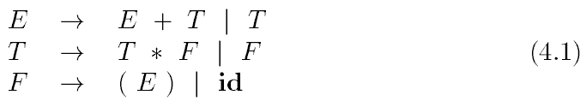
Elimination of Left Recursion
Associativity and precedence are captured in the following grammar for describing expressions, terms, and factors.
E represents expressions consisting of terms separated by + signs
T represents terms consisting of factors separated by * signs →
F represents factors that can be either parenthesized expressions or identifiers
Expression grammar (4.1) belongs to the class of LR grammars that are suitable for bottom-up parsing.
This grammar can be adapted to handle additional operators and additional levels of precedence.
However, it cannot be used for top-down parsing because it is left recursive.
Khawaja 2025

Slide 3
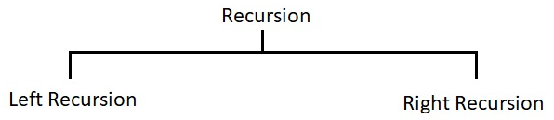

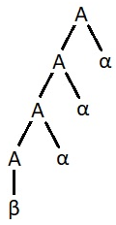



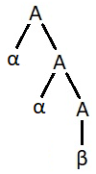






Elimination of Left Recursion - Example
A → Aα₁ | Aα₂ | … | Aα_{m} | β₁ | β₂ | … | β_{n}
A → β₁A’ | β₂A’ | … | β_{n}A’
A’ → α₁A’ | α₂A’ | … | α_{m}A’ | ε
E → E + T | T
A → Aα | β
E → TE’
E’ → +TE’ | ε
Khawaja 2025

Slide 4

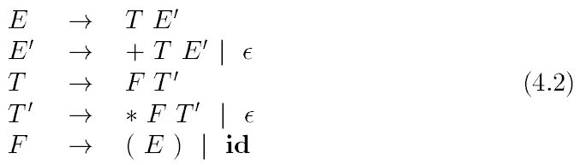
Elimination of Left Recursion (ctd)
A grammar is left recursive if it has a nonterminal A such that there is a derivation for some string α.
Top-down parsing methods cannot handle left-recursive grammars, so a transformation is needed to eliminate left recursion.
The following non-left-recursive variant of the expression grammar (4.1) will be used for top-down parsing:
Khawaja 2025

Slide 5
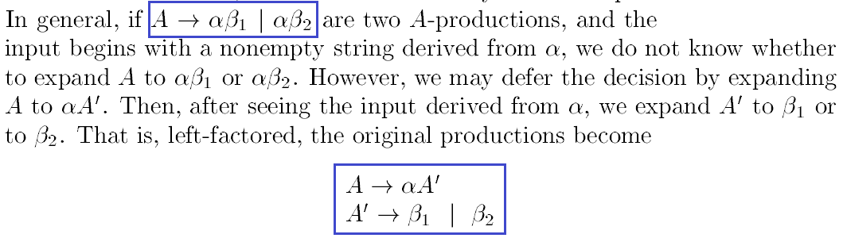
Applying Left Factoring
Left factoring is a grammar transformation that is useful for producing a grammar suitable for predictive (a type of top-down) parsing.
When the choice between two alternative A-productions is not clear, we may be able to rewrite the productions to defer the decision until enough of the input has been seen that we can make the right choice.
Khawaja 2025

Slide 6



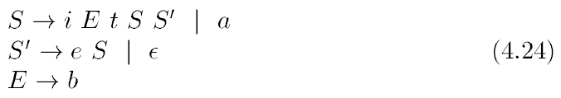
Applying Left Factoring (ctd)
Khawaja 2025

Slide 7
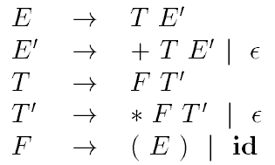
Top-Down Parsing
Top-down parsing can be viewed as the problem of constructing a parse tree for the input string, starting from the root and creating the nodes of the parse tree in preorder (depth-first) Note: Preorder Traversal is in the order of current-left-right nodes
Equivalently, top-down parsing can be viewed as finding a leftmost derivation for an input string.
The sequence of parse trees in Fig. 4.12 for the input id+id*id is a top-down parse according to grammar:
Khawaja 2025

Slide 8
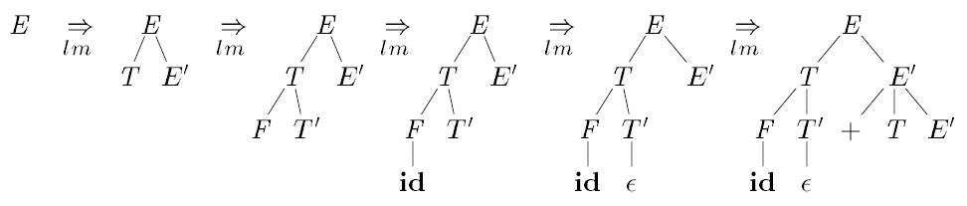
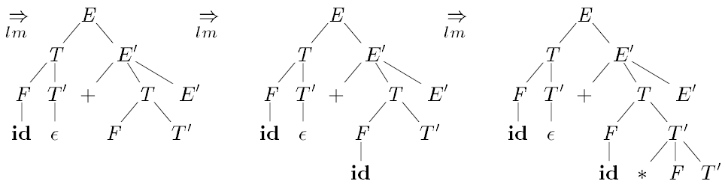
Top-Down Parsing (ctd)
This sequence of trees corresponds to a leftmost derivation of the input: id+id*id
Khawaja 2025

Slide 9
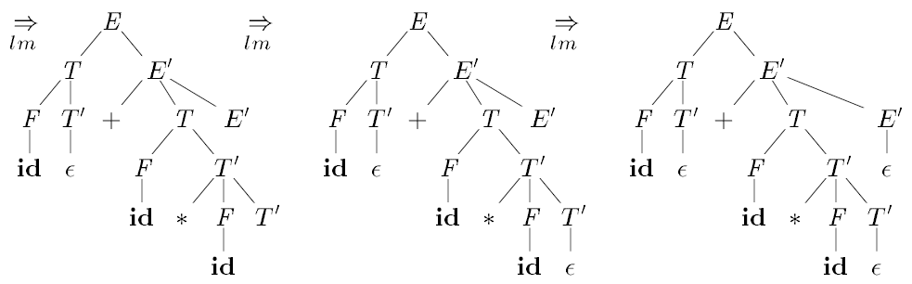
Top-Down Parsing (ctd)
id+id*id
At each step of a top-down parse, the key problem is that of determining the production to be applied for a nonterminal, say A.
Once an A-production is chosen, the rest of the parsing process consists of "matching" the terminal symbols in the production body with the input string.
Khawaja 2025

Slide 10
Top-Down Parsing (ctd)
A general form of top-down parsing, called recursive-descent parsing, may require backtracking to find the correct A-production to be applied.
Another form is predictive parsing, a special case of recursive-descent parsing, where no backtracking is required.
Predictive parsing chooses the correct A-production by looking ahead at the input a fixed number of symbols, typically we may look only at one (that is, the next input symbol).
For example, consider the top-down parse in Fig. 4.12, which constructs a tree with two nodes labeled E'. At the first E' node (in preorder), the production E' --> +TE' is chosen; at the second E' node, the production E' --> ε is chosen. A predictive parser can choose between E'-productions by looking at the next input symbol.
The class of grammars for which we can construct predictive parsers looking k symbols ahead in the input is sometimes called the LL(k) class.
Khawaja 2025

Slide 11
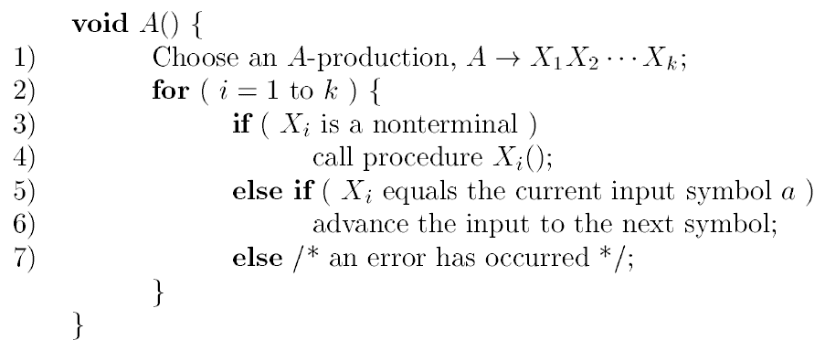
Recursive-Descent Parsing
A recursive-descent parsing program consists of a set of procedures, one for each nonterminal.
Execution begins with the procedure for the start symbol, which halts and announces success if its procedure body scans the entire input string.
Pseudocode for a typical nonterminal appears in Fig. 4.13. Note that this pseudocode is nondeterministic, since it begins by choosing the A-production to apply in a manner that is not specified.
Khawaja 2025

Slide 12
Recursive-Descent Parsing (ctd)
General recursive-descent may require backtracking; that is, it may require repeated scans over the input. However, backtracking is rarely needed to parse programming language constructs, so backtracking parsers are not seen frequently.
To allow backtracking, the code of Fig. 4.13 needs to be modified. First, we cannot choose a unique A-production at line (1), so we must try each of several productions in some order. Then, failure at line (7) is not ultimate failure, but suggests only that we need to return to line (1) and try another A-production.
Only if there are no more A-productions to try do we declare that an input error has been found.
In order to try another A-production, we need to be able to reset the input pointer to where it was when we first reached line (1).
Khawaja 2025

Slide 13

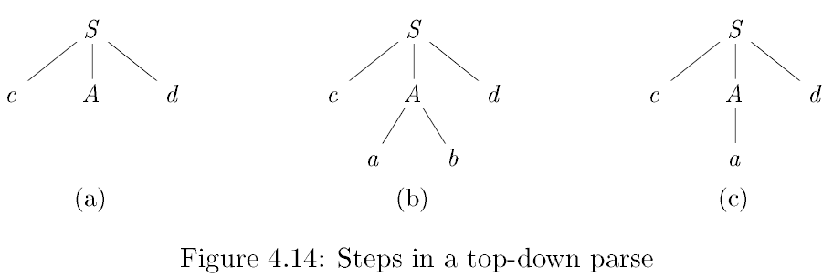
Example: Recursive-Descent with Backtracking
To construct a parse tree top-down for the input string w = cad, begin with a tree consisting of a single node labeled S, and the input pointer pointing to c, the first symbol of w.
In (b) since terminal b does not match d, we report failure and go back to A to see whether there is another alternative for A that has not been tried, and that might produce a match.
Khawaja 2025

Slide 14
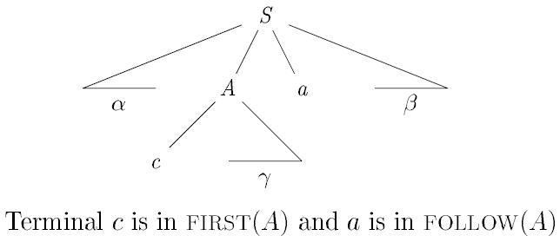
FIRST and FOLLOW
The construction of both top-down and bottom-up parsers is aided by two functions, FIRST and FOLLOW, associated with a grammar G.
During top-down parsing, FIRST and FOLLOW allow us to choose which production to apply, based on the next input symbol.
Khawaja 2025

Slide 15
Computing FIRST
To compute FIRST(X) for all grammar symbols X, apply the following rules until no more terminals or ε can be added to any FIRST set:
Every first terminal derivable using productions of X.
If X → ε , then ε is also in FIRST(X).
If X → Y , and Y is a non-terminal, then FIRST(Y) will also be in FIRST(X).
If X → Y₁Y₂ , and Y₁ → ε , then FIRST(Y₂) will also be in FIRST(X).
Khawaja 2025

Slide 16
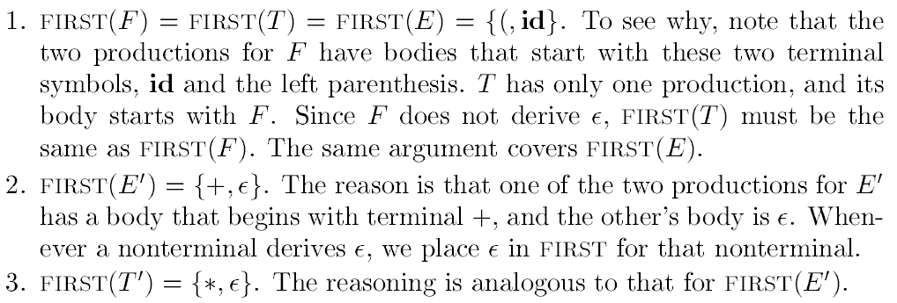
FIRST - Example
Considering the given left-recursive grammar:
Khawaja 2025

Slide 17
Computing FOLLOW
To compute FOLLOW(A) for all non-terminals A, apply the following rules until nothing can be added to any FOLLOW set:
For FOLLOW(X), use productions that contain X in the body.
Place $ in FOLLOW(S), where S is the start symbol, and $ is the input right end marker.
If there is a production A → WXY, then everything in FIRST(Y) except ε is in FOLLOW(X). (Note: ε is not written in FOLLOW set)
If there is a production A → WX, or a production A → WXY, where FIRST(Y) contains ε, then look at the head of production, which is A, everything in FOLLOW(A) is in FOLLOW(X).
Khawaja 2025

Slide 18
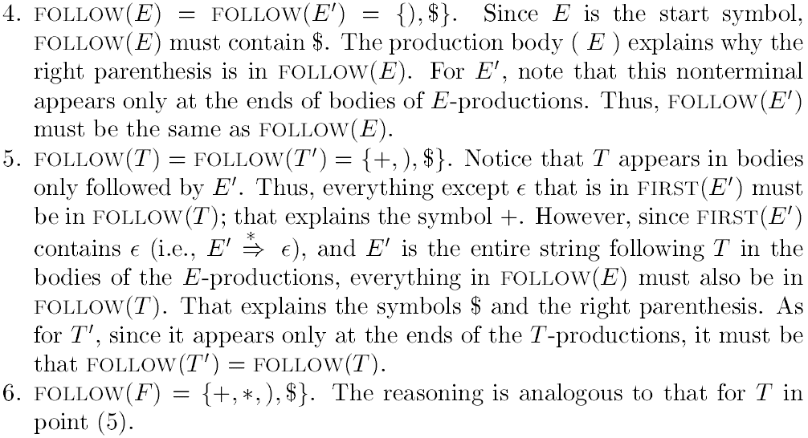
FOLLOW – Example
Khawaja 2025

Slide 19
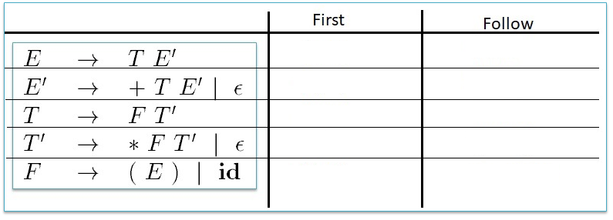
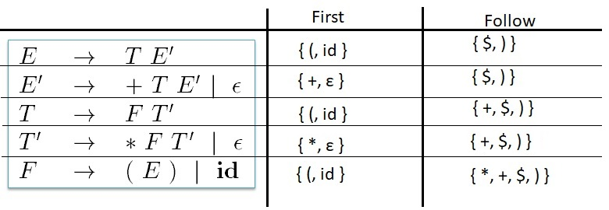
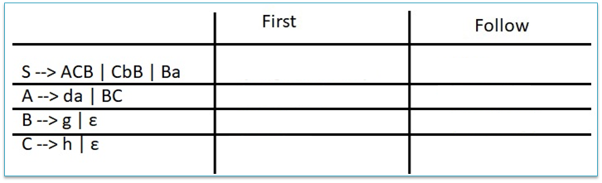
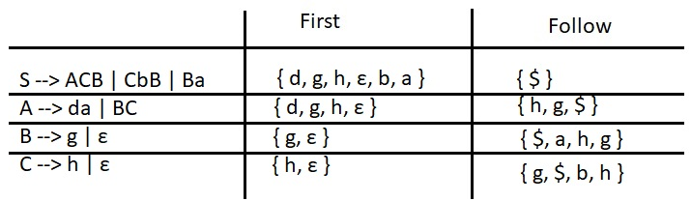
FIRST and FOLLOW – Examples
Khawaja 2025

Slide 20
LL(1) Grammars
Predictive parsers, that is, recursive-descent parsers needing no backtracking, can be constructed for a class of grammars called LL(1).
The first "L" in LL(1) stands for scanning the input from left to right.
The second "L" for producing a leftmost derivation.
The "1" for using one input symbol of lookahead at each step to make parsing action decisions.
The class of LL(1) grammars is rich enough to cover most programming constructs, although care is needed in writing a suitable grammar for the source language. For example, no left-recursive or ambiguous grammar can be in LL(1).
Khawaja 2025

Slide 21
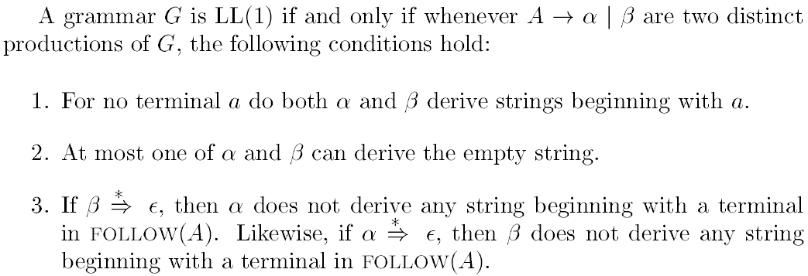
LL(1) Grammars (ctd)
Khawaja 2025

Slide 22
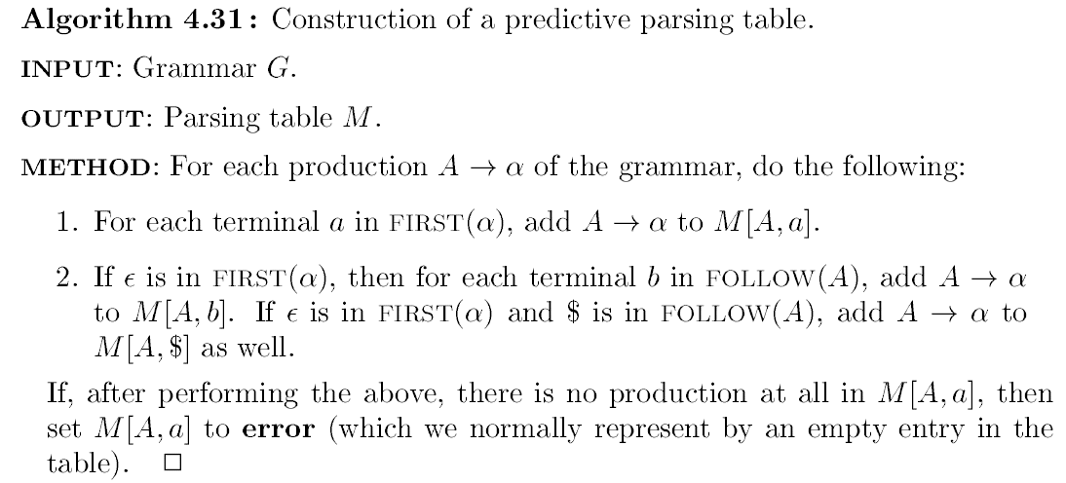
Predictive Parsing Table
Khawaja 2025

Slide 23
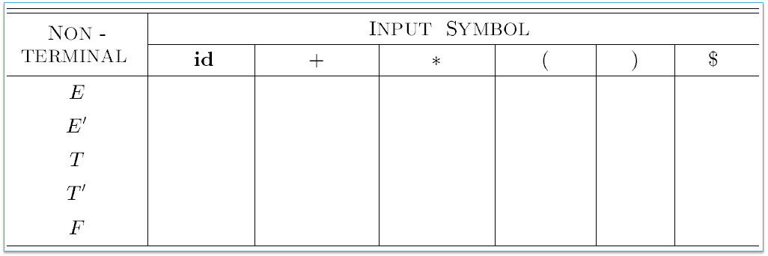
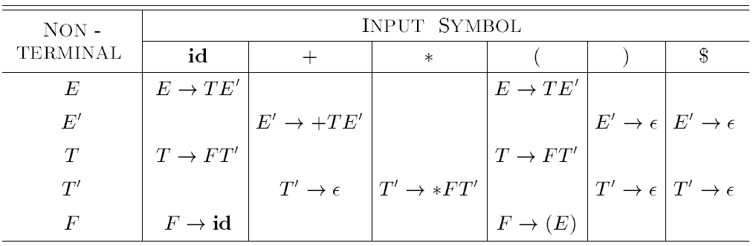
Predictive Parsing Table – Example 1
Khawaja 2025

Slide 24
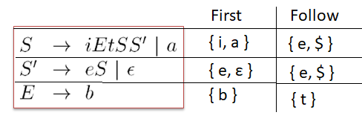
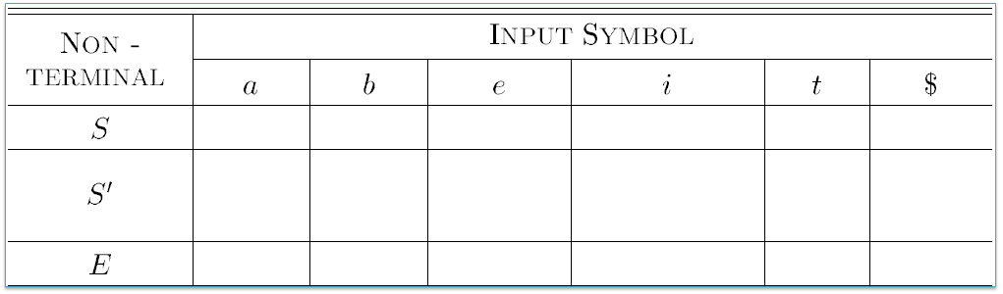
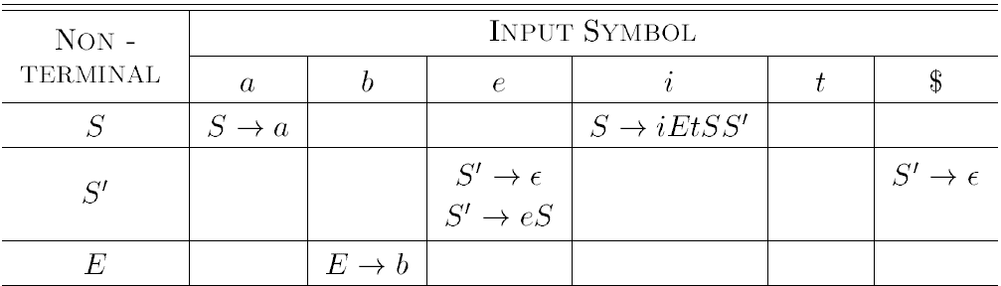
Predictive Parsing Table – Example 2
Khawaja 2025

Slide 25
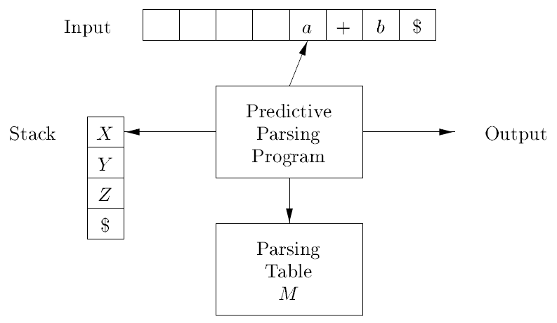
Predictive Parsing Process
Khawaja 2025

Slide 26
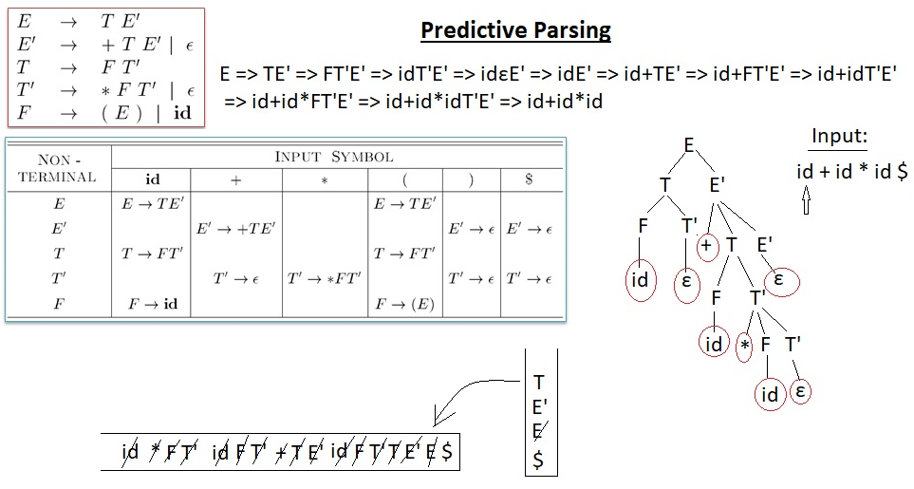
Predictive Parsing Process (ctd)
Khawaja 2025

Slide 27
Summary Questions
Name the three transformation techniques used to prepare a grammar for Top-down parsing?
After applying all three transformations, what class of grammar the resulting grammar belongs to?
Which type of derivation technique utilized in Top-down parsing?
How is Predictive Parsing related to Recursive-descent Parsing?
Why is Predictive Parsing Table important?
If there are more than one entries in a single cell of the predictive parsing table then what does this indicate?
What notation is used to indicate the end of input?
What notation is used to indicate the bottom of the stack?
Khawaja 2025

